Slide 1
Movie recommendation System
Unified mentor project

Slide 2
Building movie recommendation system
This presentation outlines the creation of a movie recommendation system similar to netflix.
We used python, machine learning and streamlit

Slide 3
Recommendation system overview
Content Based Filtering :-
This methos suggests movies similar to those those a user liked in the past.
Recommendations are based on movie attributes like genre and actors.

Slide 4



Project architecture
API Data
Real-time movie data is fetched from external APIs
This ensures recommendations are current
ML Models
Machine learning models saved using pickle for efficient loading
Allows for quick predictions
Streamlit Frontend
Streamlit is used to create an interactive user interface.
Easy interaction for users

Slide 5
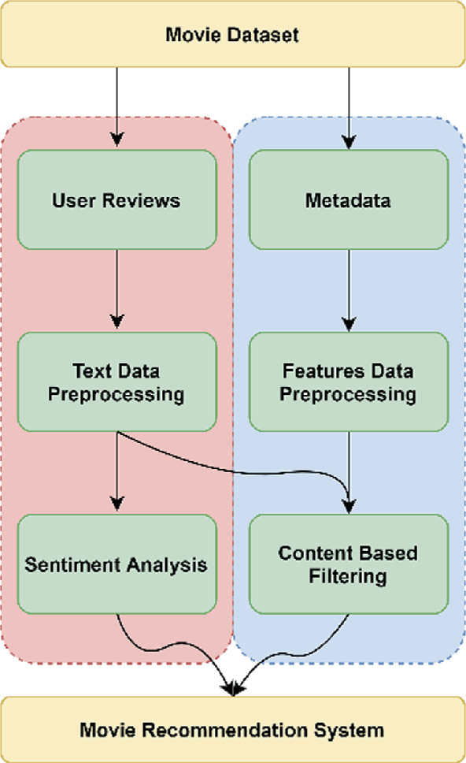
Implementation
Data Fetching
Obtain movie data from APIs like IMDB
Collect relevant movie attributes
Pre-processing
Clean and prepare the data for model training.
Handle missing values and normalize data
Model Training
Training machine learning models using the pre-processed data
We used content based filtering

Slide 6





Key python libraries
Pandas
Used for data manipulation and analysis
Scikit-learn
For machine learning model development
Streamlit
To build the interface web application
Streamlit
Requests
For fetching data from APIs

Slide 7

End result:

Slide 8
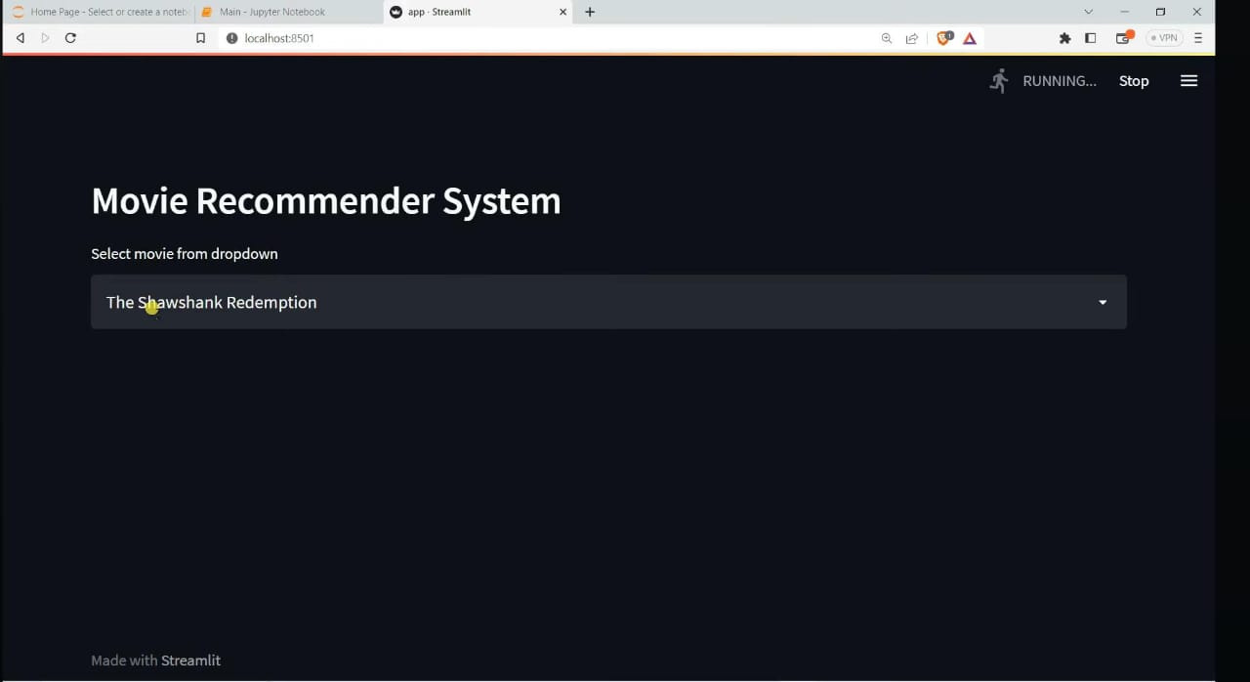

Slide 9
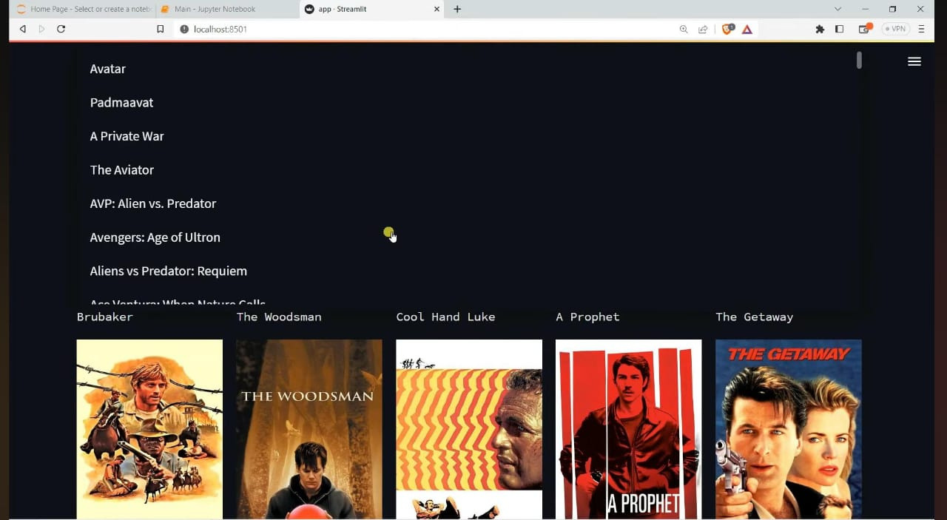

Slide 10
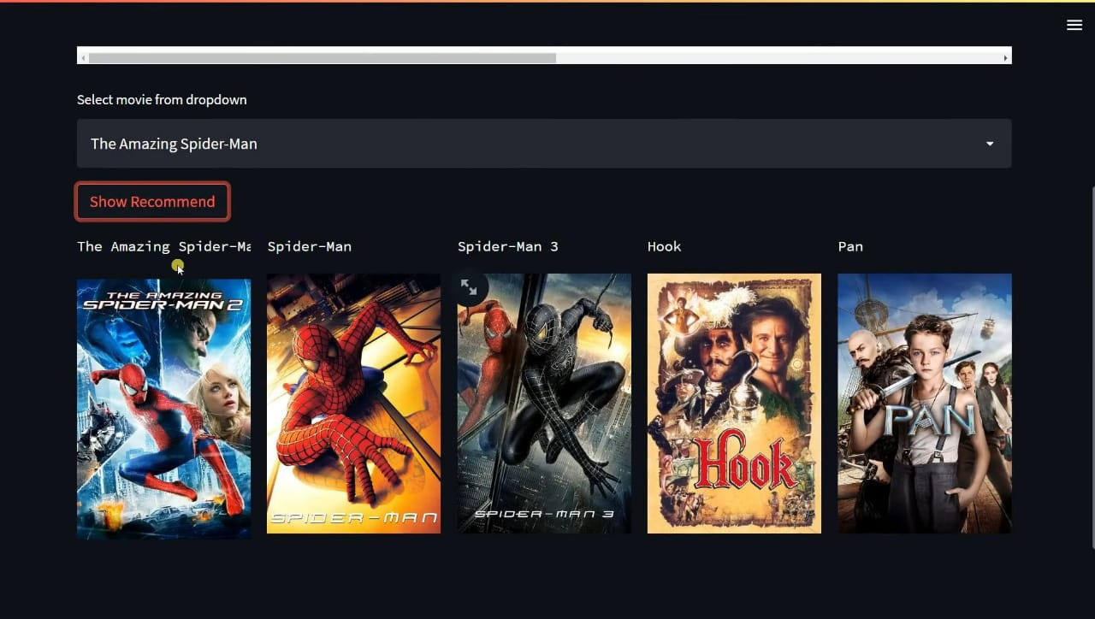

Slide 11
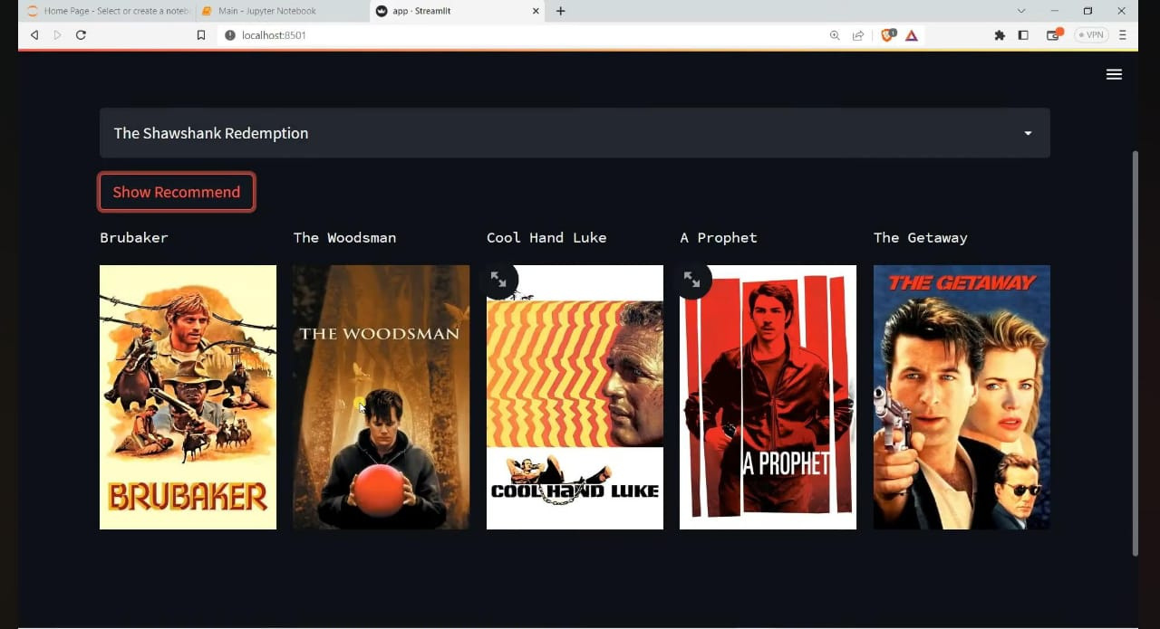

Slide 12
BY Sourav Mohanty thesouravmohanty@gmail.com

